Slide 1
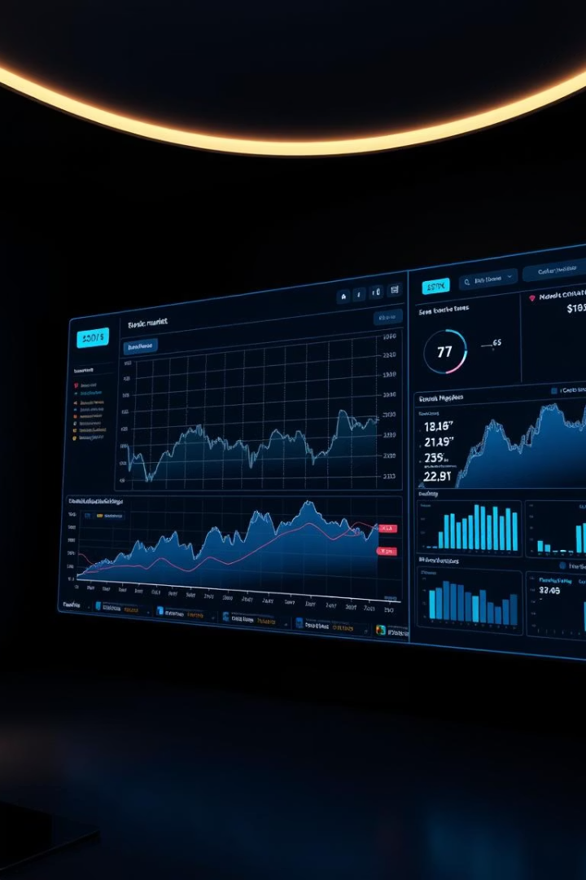
Introducing the Future of Stock Analytics
Discover a platform that transforms stock analysis with custom date ranges and powerful insights.

Slide 2

The Problem: Data Overload, Limited Insight
Massive Data
Limited Tools
Investors face overwhelming amounts of stock data daily.
Current systems lack customizable, historical data analysis.
Missed Moves
Delayed insights lead to missed investment opportunities.

Slide 3
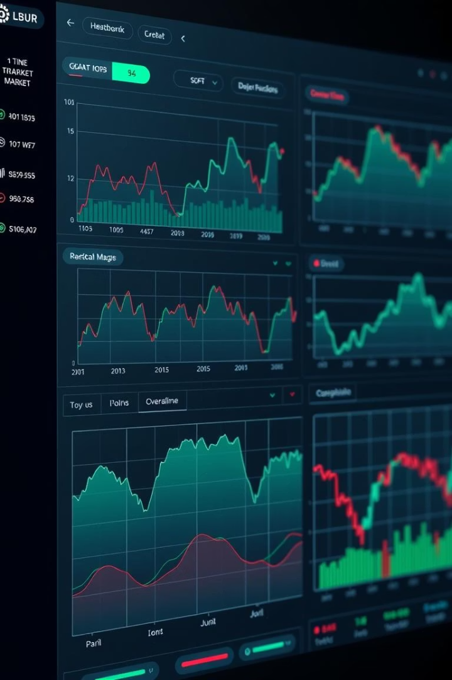
Our Solution: A Powerful Analytics Platform
Date-Range Driven
Advanced Visualizations
Analyze stocks over any custom period easily.
Charts, heatmaps, and graphs reveal trends clearly.
Real-Time Data
Get up-to-the-minute market updates instantly.

Slide 4
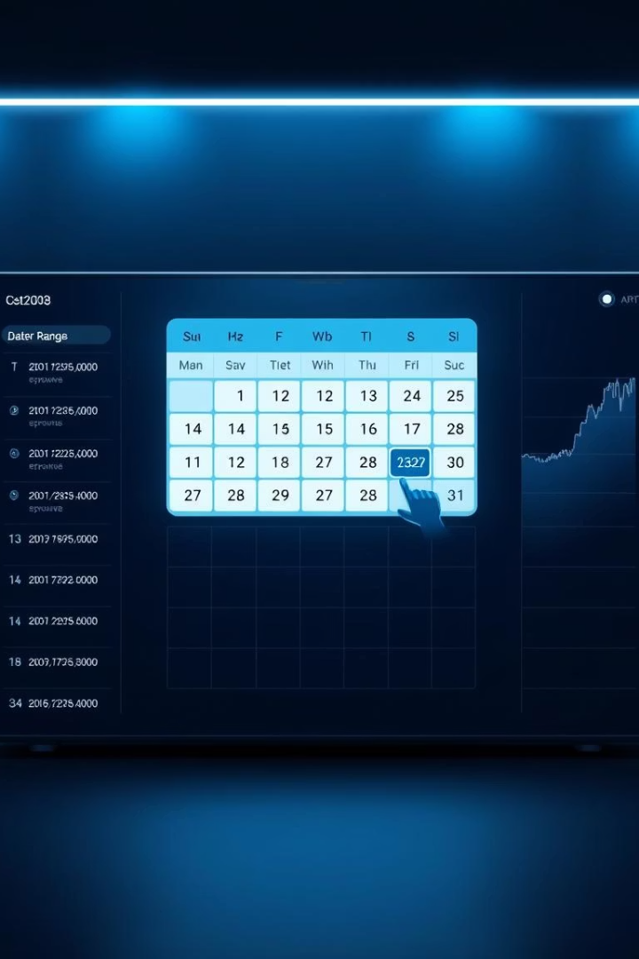
Key Features: Date Range Selection
Intuitive Interface
Easy calendar tool to pick date ranges fast.
Event-Based Analysis
Examine trends around economic events precisely.
Compare Timeframes
Evaluate performance across multiple periods.

Slide 5



Advanced Analytics: Unveiling Hidden Patterns
Fundamental Analysis
2
Financial ratios highlight company health and growth.
Technical Indicators
RSI, MACD, and moving averages reveal momentum.
1
Correlation Analysis
3
Identify linked stocks and sector relationships.

Slide 6
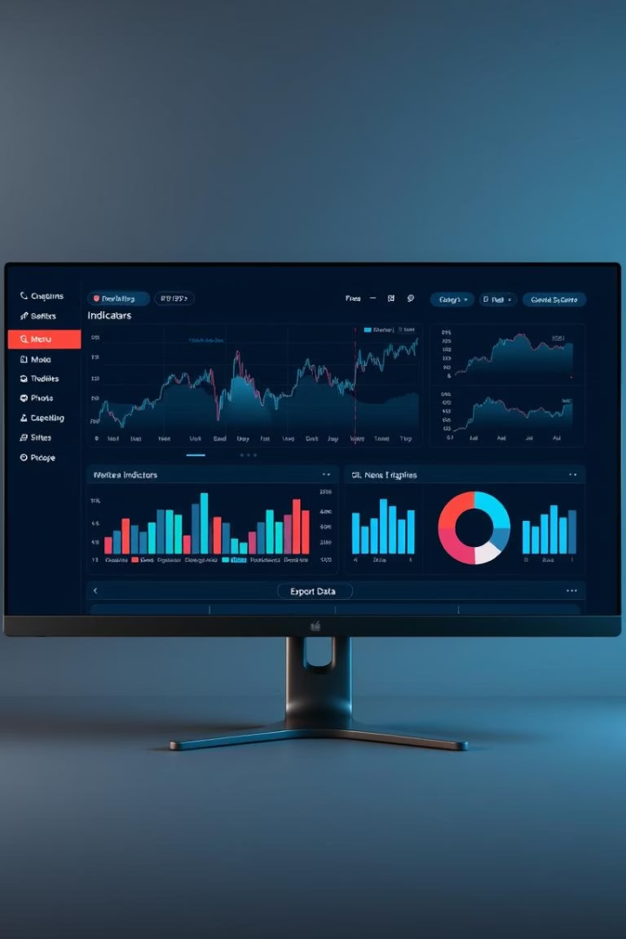



Customizable Visualizations: See the Story
Interactive Charts
Explore data with dynamic visual tools.
Custom Overlays
Add indicators and tailor views per need.
Data Export
Export insights for deeper offline analysis.

Slide 7
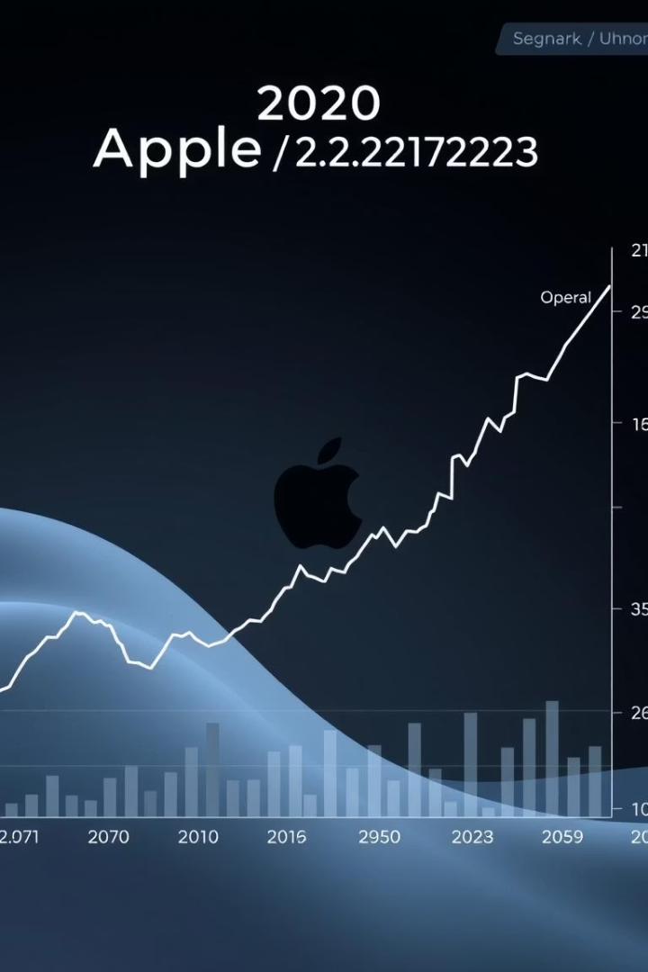
Real-World Example: Analyzing Apple (AAPL)
Select Date Range
January 1 to December 31, 2023 for full-year insight.
Visualize Trends
Track price, volume, and key technical indicators.
Find Entry/Exit
Use historical patterns to optimize trades.

Slide 8
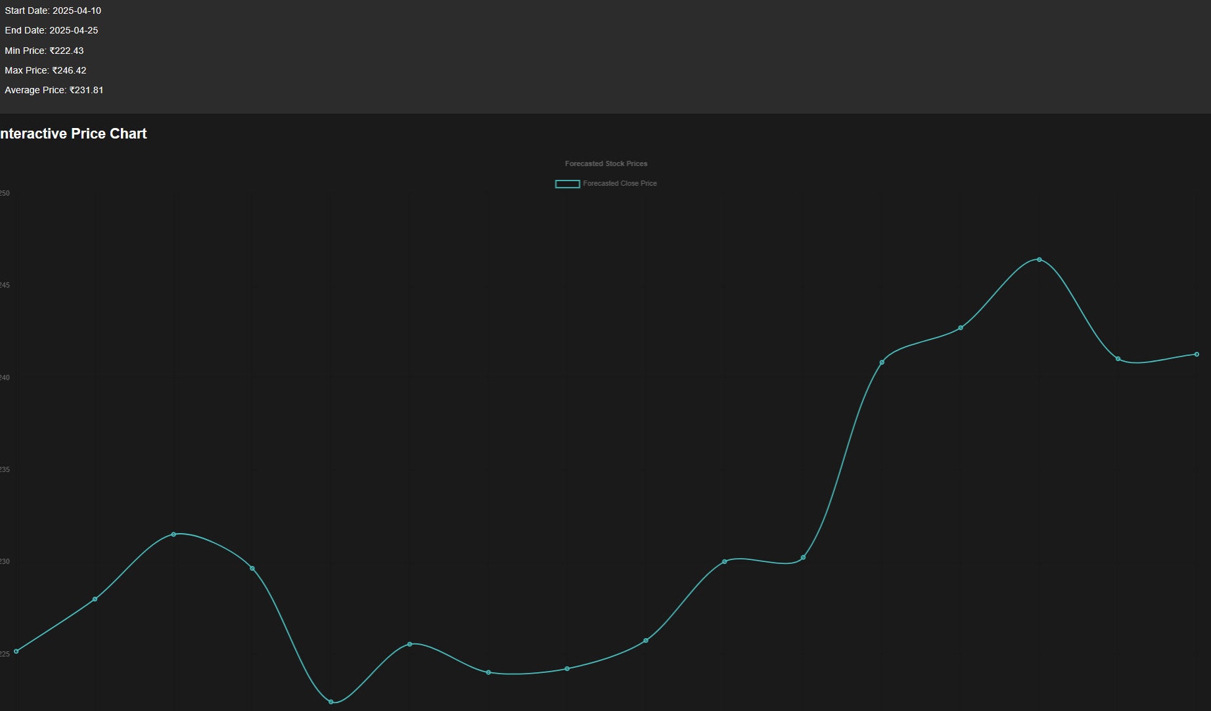

Slide 9

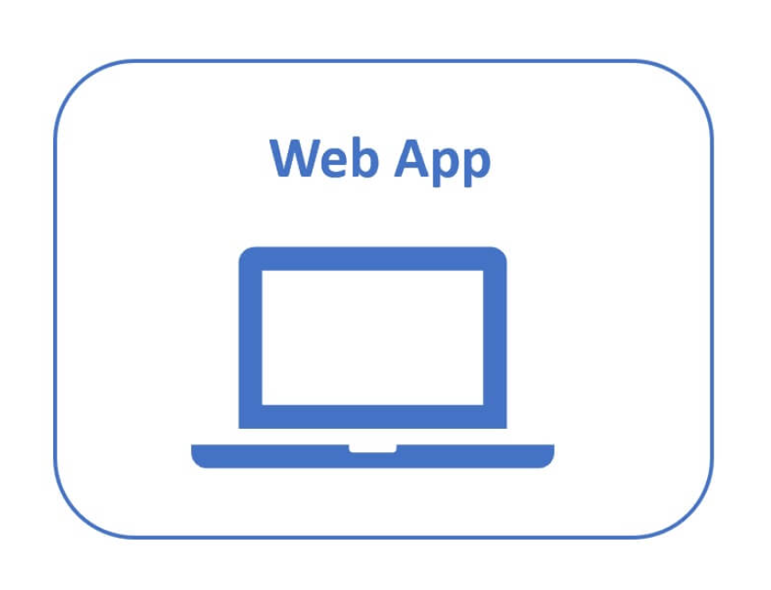
GITHUB LINK: GitHub
WEB APP LINK : StockAnalysis

Slide 10
Use Cases: Empowering Investors
Day Traders
Long-Term Investors
Portfolio Managers
Spot short-term opportunities with real-time data.
Evaluate growth through detailed historical trends.
Optimize asset mixes using correlation and performance.

Slide 11




Competitive Advantages: Why Choose Us?
Data Accuracy
User Interface
Affordable Pricing
Reliable, validated market information you can trust.
Intuitive and customizable dashboards for comfort.
Flexible plans accessible for all investor profiles.

Slide 12


Unlock Your Investment Potential Today
Free Trial
Experience

Slide 13
THANK YOU

